Slide 1
Software Development Life Cycles
© Prof. Ernest Cachia
Edited by Dr Mark Micallef

Slide 2
Session 3
Phased Development and Life-Cycles
This session should provide an clear insight into what phased software development is, what it aims to achieve, and how it achieves it. Furthermore, various “prominent” and representative software development life-cycles (SDLCs) are introduced in preparation for further discussion.

Slide 3
Session Aims
The scope of this session is to instil in you an appreciation for the need of fragmenting the development process and precisely defining each part. You will also learn to understand the composition and application of various SDLCs. The concepts behind the use of prototypes will also be tackled.

Slide 4
Session Contents
Phased development
Milestones
Software development life-cycles
Prototyping

Slide 5
Breaking the Monolithic Model
Done by introducing “steps” into the software development process.
Steps in the development process are called “phases” (or “stages”).
Phases must be self contained and pre-defined.
Phases should decrease abstraction as they progress.

Slide 6
Phased Development
Monolithic process (?)
No management potential!
Phased process
…
…
Phase “i”
Phase “i+1”
Phase “n”
Milestone “i”
Milestone “i+1”
Milestone “n”
Structured & focused management

Slide 7
A Software Development Phase
A software development phase:
Is a delimited period of time within the process of development of a software system.
Has a definite starting set of data and a definite set of results.
Is based on the results of earlier phases.

Slide 8
Advantages of Phased Development
Phased development
Offers benchmarking
Offers insight
Offers mile-stoning niches
Offers a documentation-building framework
Offers a definite progression sequence
Offers possibilities for prototyping
Allows end-user and client participation
Offers possibilities for better testing strategies

Slide 9
A Development Milestone
A software development milestone is a scheduled event…
for which some project member or manager is accountable.
is used to measure progress.
A milestone typically includes:
A formal review.
The issuance of documents.
The delivery of a (sometimes intermediate) product.

Slide 10
Typical Software Development Phases
Feasibility
Feasibility study
Implementation
Strategy planning
Component
Requirements
Elicitation
Integration
Testing
Statement
Installation
Analysis
System
Operations
Maintenance
Detailed
Support
Design
System
Retirement
Detailed

Slide 11
Phases are Neutral and Composable
The Life-Cycle
Feasibility
Requirements
Maintenance
Design
Implementation
Analysis
Testing

Slide 12
Activities During Phases
Requirements: establish the customer’s needs
System Design: develop the system’s structure
Detailed Design: develop module structures
Implementation: code or otherwise
Testing: check what’s been developed
Installation: bring the system into production
Maintenance: correct, adapt, improve

Slide 13
Traditional software development effort spread

Slide 14
The Development Life-Cycle
(Also known as the Software Development Process)
A project is a set of activities, interactions and results.
A life-cycle or a software process is the organisational framework for a project.

Slide 15
Life Cycle (ANSI / IEEE Standard 729-1983)
A life-cycle…
is a finite and definite period of time.
starts when a software product is conceived.
ends when the product is no longer available or effective for use.
Any life-cycle is organised in (composed of) phases

Slide 16
Types of SDLC
More than one possible life cycle can be adopted to attain a particular goal.
The type of SDLC is defined by the way it links its component development phases.
In theory, any combination of phases is possible, however, in practice only ones that lead to a visible and controllable development process are useful.
A type of SDLC is also known as a Development Model.

Slide 17
The Nature of an Effective DM
An effective DM is one that:
Effectively links the phases it includes
Focuses phases towards a definite goal
Provides mechanisms for the controlled decrease of system abstraction
Includes definite milestones
Is transparent
Is traceable between adjacent phases

Slide 18
Some Representative Life-Cycles
Development model definition:
A particular interaction configuration of development phases leading to a final software product.
Waterfall
V-model
Evolutionary Prototyping (aka Incremental)
Throw-away Prototyping (aka Rapid)
Rapid Application Development (RAD)
Agile Development
These will be outlined in the next slides.

Slide 19
The Waterfall Model
Is the root of all other models
Still prevalent in general
Exists in many versions
Supported by many methods/techniques
Has many drawbacks!

Slide 20
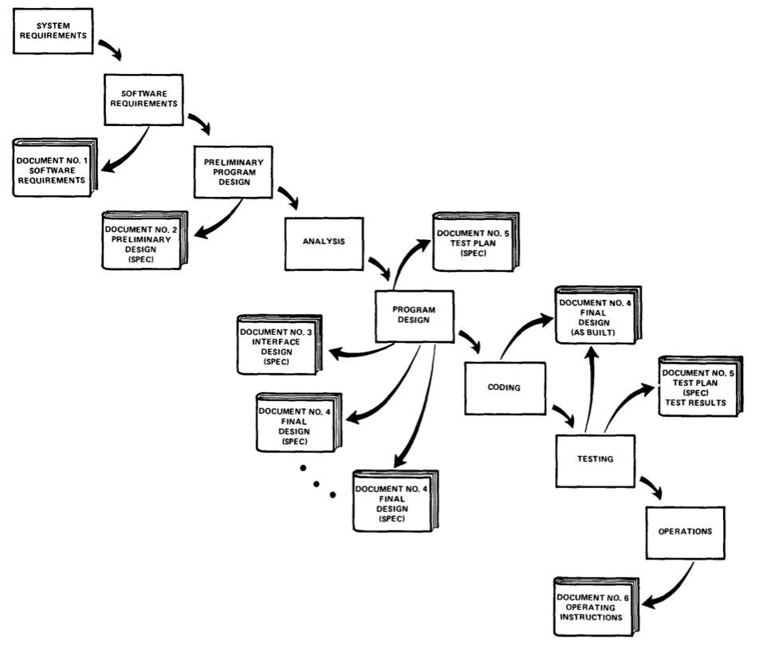
The Waterfall Model

Slide 21
Fundamental Waterfall Model Properties
Sequential nature
All phases must happen in a predefined sequence.
Transformability
Any given phase can be directly attributed to the preceding one.
Completeness
Any given phase must fully completed before the next phase can be started.

Slide 22
Waterfall Model Drawbacks
Sequential nature
Late tangible product maturity
Late feedback to both customer and developer
Minimal risk management for both customer and developer
Late testing accuracy
Late client acceptance confirmation
Inflexible
Can be overly time-consuming

Slide 23
The V-Model
Requirements
Acceptance Test
System Design
Integration Test
Detailed Design
Module Test
Implementation

Slide 24
Analysis of the V-Model
Improves testing strategies
Does not particularly improve:
Sequential nature
Feedback
Developmental risk management

Slide 25
The Incremental Model
Requirements
Global System Design
Detailed design
Detailed design
Detailed design
Implementation
Implementation
Implementation
Testing
Testing
Testing
Maintenance

Slide 26
Analysis of The Incremental Model
Assumes independent sub-systems.
Improves (by delivering smaller units):
Feedback
Testing
Avoids the production of a monolithic product.
Does not particularly improve:
Developmental risk management
Sequential nature (still present in sub-systems)

Slide 27
The (Rapid) Prototyping Model
Goals:
to break away from the sequential nature.
to speed up feedback.
to minimise risks (for both customer and developer)
to be incomplete but executable.
to be cheap and fast.

Slide 28
What is Prototyping?
A definition (A. Davis):
A prototype is a partial implementation of a system, constructed primarily to enable customer, end-user, or developer to learn about the problem and/or its solution.
Types:
evolutionary / throw-away
horizontal / vertical

Slide 29
Horizontal Prototyping
func. 1
func. n
abstract
physical

Slide 30
Vertical Prototyping
func. 1
func. n
abstract
physical

Slide 31
Throwaway Prototyping Visual
Requirements
specification
Some minimal
development
The prototype
Decision
not acceptable
acceptable
Discard
prototype
Go on with normal system development

Slide 32
Evolutionary Prototyping Visual
Requirements
specification
Some initial
development
Some more
development
etc.
Prototype
version 1
Prototype
version 2
Continue till prototype is matured

Slide 33
Analysis of The Prototyping Model
Improves:
breaks the sequential nature.
supports fast feedback.
offers an opportunity for risk management.
Problem:
has no definite (i.e. strictly defined) organisational structure.

